Slide 1
Introduction to Loci to Speckle Distance ImageJ Module
Omid Gholamalamdari
Andrew Belmont lab
University of Illinois at Urbana-Champaign

Slide 2
Question: How to feature boundaries?
DAPI SON FISH Merge
Sum projection of 80 stacks
Can define boundaries based on %max_intensity thresholding:
Problem is noise!

Slide 3
What’s noise?
Noise Sources:
Gaussian noise
Poisson noise
Background noise
With background
Mode subtracted
Histogram of pixel intensities

Slide 4
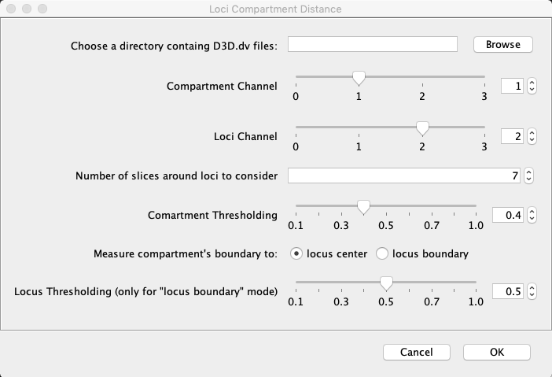
ImageJ Plugin
Folder containing *_D3D.dv files.
Multichannel 3D stack.
Might work out of the box with some other imaging files (Have not tested). The only problem that I can think of is how other files store voxel size information might be different.
The channel number containing compartment (e.g. nuclear speckle) imaging data.
The channel number containing genomic loci (e.g. FISH, LacO, TetO) imaging data.
Number of stacks to consider around the loci for sum projection.
%max signal parameter to threshold the compartment signal.
How to measure loci location (boundary or center)
%max signal parameter to threshold the loci signal
1
2
3
4
5
6
7

Slide 5
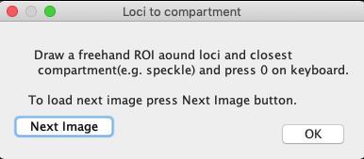
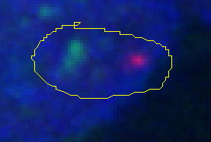
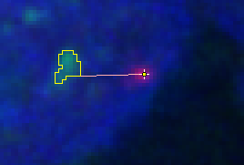
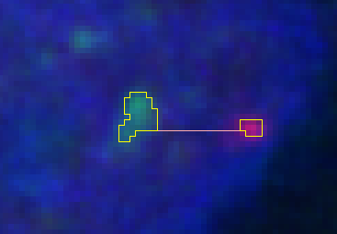
ImageJ Plugin

Slide 6
Loci compartment distance macro
Scans the folder given by user and find D3D.dv files.
User draws an ROI around loci and closest compartment (guess work!)
Find the active z
Sum-project based on parameters.
Find numerical mode (as background) in the ROI for both loci and compartment channels.
Subtract the mode from sum-project for both channels.
Define compartment boundary with thresholding.
Define locus center/boundary.
Center based on Max signal
Calculate the distance between loci and boundary.
Overlay loci/compartment on the image
Save the measurements.
User closes the current file click on “next file” button.

